Slide 1

Market Data Storage and Analysis
Presented by :- Sumit Mehta

Slide 2

INTRODUCTION
This dataset has information about companies, their stock prices, trading activities, financial deals, and performance metrics like revenue and profit. It helps understand how companies are doing in the market and their overall financial health.

Slide 3

ABOUT PROJECT
This project studies financial and market data using SQL tools like aggregate functions, joins, and filters. It looks at trends in revenue, profit, stock prices, trading volumes, and market value. By organizing and comparing data, the project helps to understand how companies and industries are performing.

Slide 4
Tables of the Dataset
company_data : Contains company details like name, industry, country, founding year, and market capitalization.
stock_price_data : Records daily stock prices including open, close, high, low, and trading volume.
trading_volume_data : Tracks buy, sell, and net trading volumes for each company on a specific date.
financial_transaction_data : Captures details of financial transactions like amount, type, and currency for each company.
company_performance_data : Provides financial performance metrics including revenue, profit, and EPS for each company on specific dates.

Slide 5
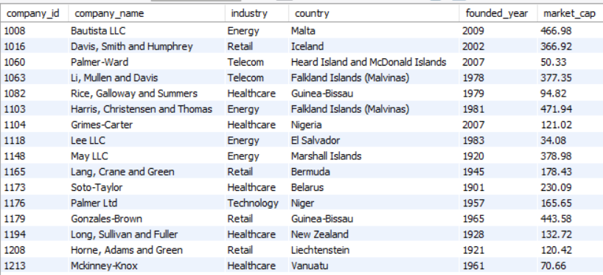
Table Overview
company_data :

Slide 6
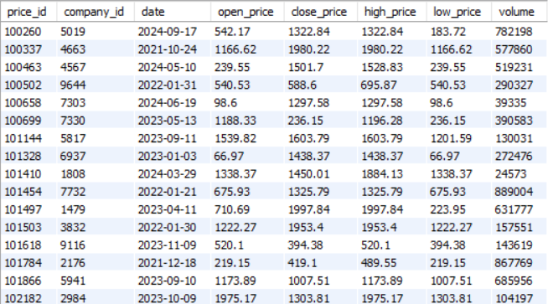
stock_price_data :

Slide 7
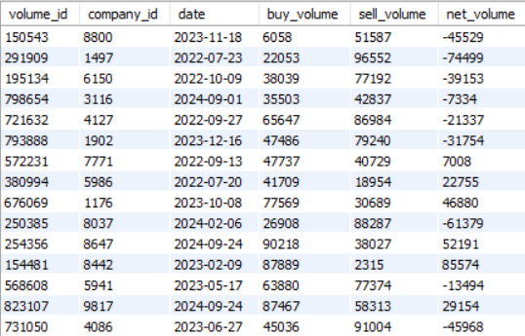
trading_volume_data :

Slide 8
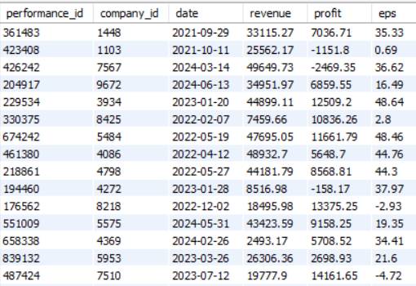
company_performance_data :

Slide 9
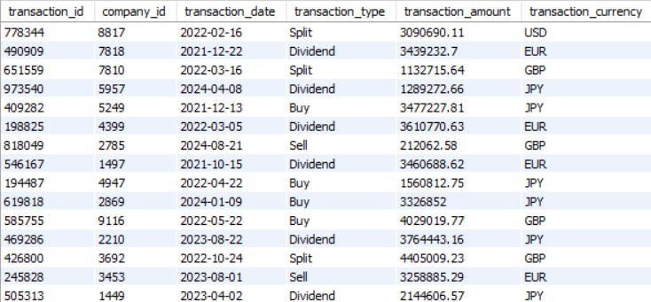
financial_transaction_data :

Slide 10
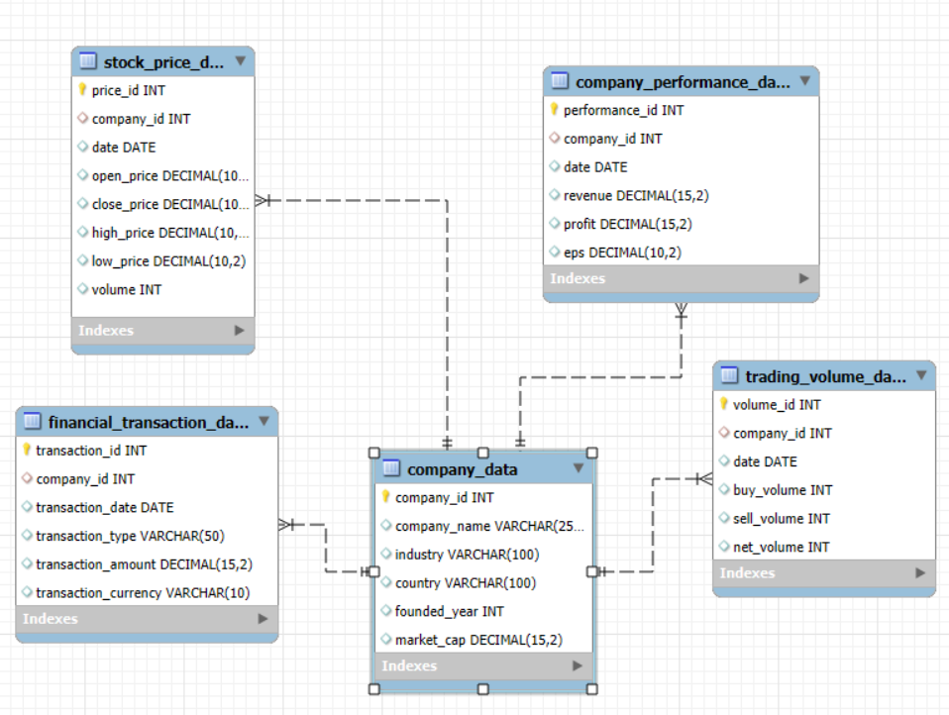
EER DIAGRAM

Slide 11
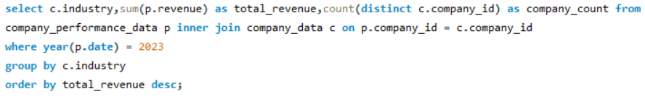
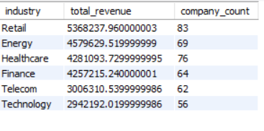
Identify top industries by revenue contribution:
1) We want to find out which industries contributed the most to the overall revenue in 2023.
Conclusion: The query shows the industries with the highest total revenue in 2023, helping us identify the key sectors driving growth in that year.

Slide 12
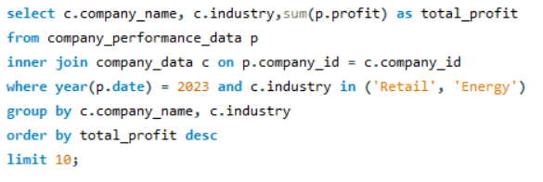
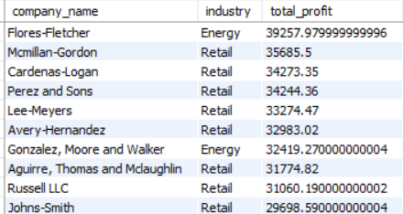
Find the most profitable companies in top industries:
2) We aim to identify the most profitable companies within top-performing industries.
Conclusion:
By focusing on the most profitable companies in industries like Retail and Energy, this query helps pinpoint the leaders in terms of profit generation.

Slide 13
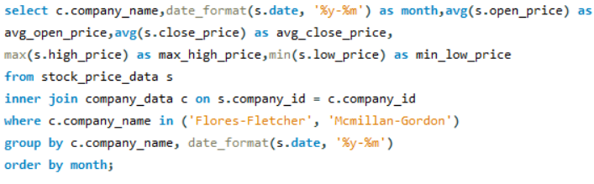
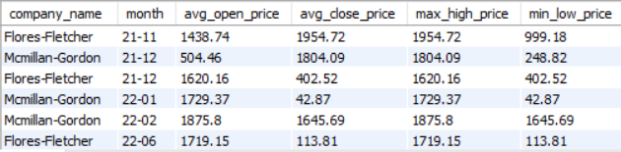
Analyze monthly stock price trends for top companies :
3) We need to analyze how stock prices have changed month by month for the leading companies.
Conclusion:
This query tracks the monthly trends in stock prices (opening, closing, highs, and lows), allowing us to monitor the stock performance of top companies over time.

Slide 14
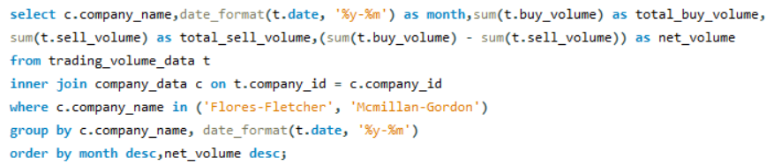
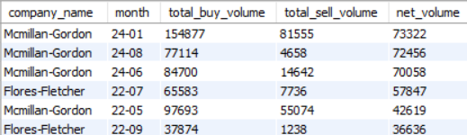
Evaluate trading volume fluctuations for top companies :
4) We want to analyze trading volume fluctuations for the top companies according to the net volumes.
Conclusion:
By examining the buy and sell volumes, we can see how investor activity varied month by month, which may indicate market interest or sentiment toward certain companies.

Slide 15
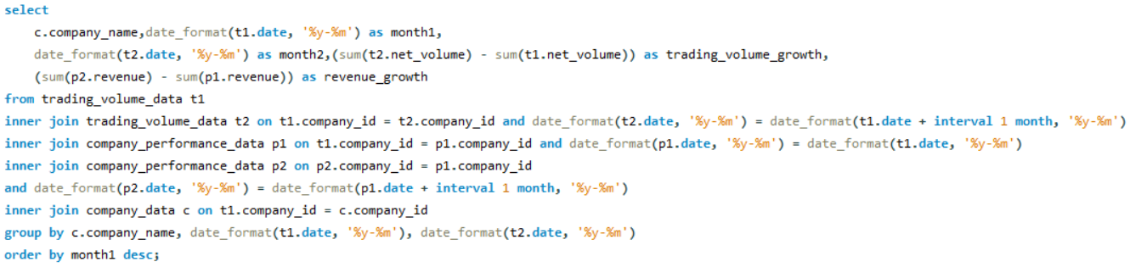
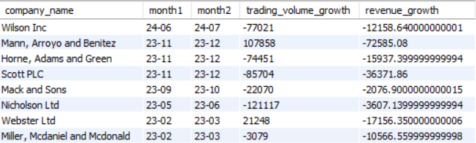
Correlate trading volume growth with revenue growth :
5) We are interested in understanding the relationship between trading volume growth and revenue growth for companies.
Conclusion:
This query helps identify if increased trading activity is linked to higher revenue growth, showing the connection between market activity and company performance.

Slide 16
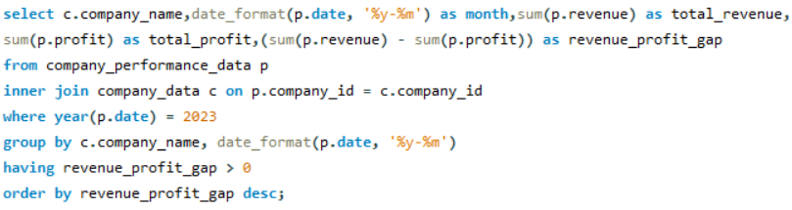
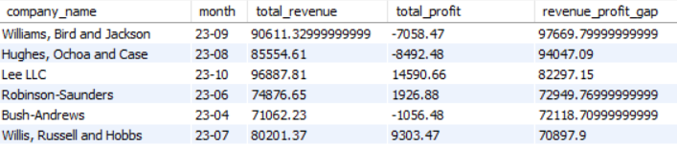
Identify revenue and profit gaps by month :
6) We want to compare the revenue and profit of companies to see if there’s a gap between the two.
Conclusion:
By comparing revenue and profit figures, this query helps identify companies with significant gaps, suggesting they may have high sales but lower profitability.

Slide 17
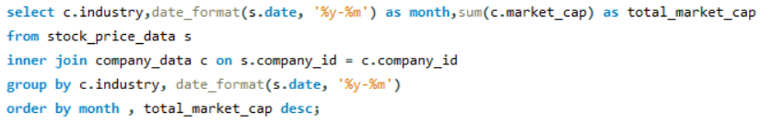
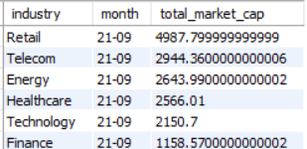
Assess market cap trends for industries :
7) We need to assess how market capitalizations for different industries have changed over time.
Conclusion:
This query tracks changes in the total market cap for each industry, giving us insight into which sectors are growing in value and attracting more investments.

Slide 18
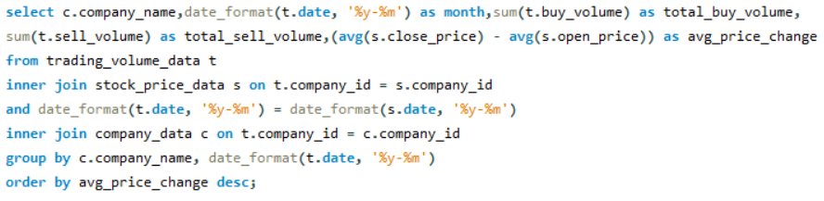
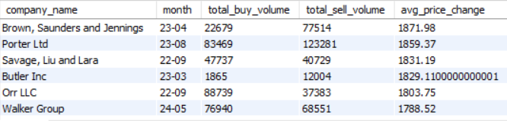
Link buy/sell volumes with stock price changes :
8) We want to understand how buy and sell volumes are related to changes in stock prices.
Conclusion:
By comparing trading volumes with stock price movements, this query highlights how investor activity may influence price fluctuations, helping us understand market behavior.

Slide 19
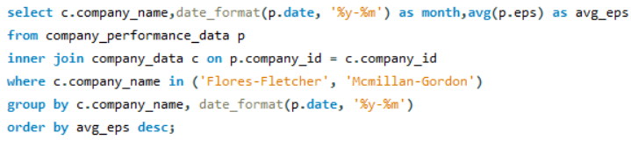
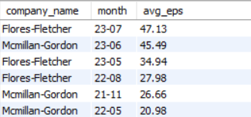
Compare eps trends across companies :
9) We aim to compare the Earnings Per Share (EPS) trends across different companies.
Conclusion:
Tracking EPS for top companies helps us identify those with the strongest earnings growth, which is often a sign of good financial health and investor confidence.

Slide 20
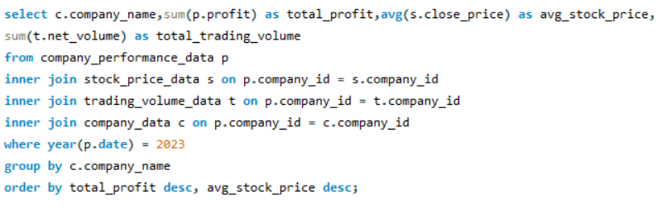
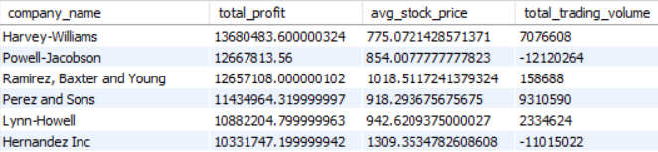
Final summary: top performing companies :
10) We want to summarize the performance of top companies by considering their profits, stock prices, and trading volumes.
Conclusion:
This final query brings together key data on profit, stock price, and trading volume to identify the companies with the best overall performance in 2023.

Slide 21
Conclusion
The analysis highlights top industries driving revenue growth, with technology and finance leading in 2023. Key companies showed strong profitability, revenue growth, and EPS trends, supported by rising trading volumes. Market cap trends revealed growing investor confidence in specific sectors. Overall, top-performing companies excelled in profit, stability, and market activity, showcasing industry leadership.

Slide 22


